Slide 1
Health monitoring application

Slide 2
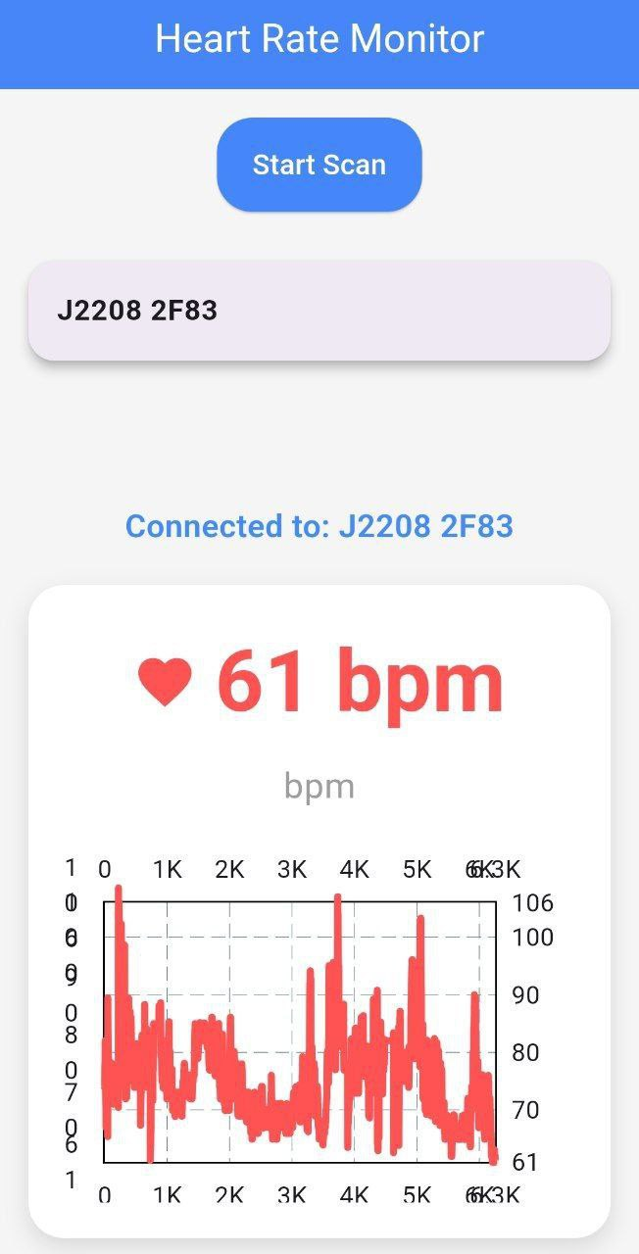
HMA

